Slide 1


Principles of Programming Languages
(CS F301)
Jabez Christopher
Assistant Professor
Department of CSIS

Slide 2

Principles of Programming Languages
(CS F301)
Names, Bindings and Scope
Jabez Christopher
Assistant Professor
Department of CSIS

Slide 3
Binding – Variable to Data Type: STATIC BINDING
EXPLICIT DECLARATION: lists variable names and specifies that they are a particular type
IMPLICIT DECLARATION: associates variables with types through default conventions, rather than declaration.
Naming conventions: the compiler or interpreter binds a variable to a type based on the syntactic form of the variable’s name
Type inference: the context of the appearance of a name is the basis for determining its type.
Implicit and default declarations can be detrimental to reliability

Slide 4
Binding – Variable to Data Type: DYNAMIC BINDING
The variable is bound to a type when it is assigned a value in an assignment state-
ment.
May also bind the variable to an address and a memory cell, because different type values may require different amounts of storage.
Names can be bound to variables and variables can be bound to types.
Advantage: Programming flexibility
Disadvantages:
Speed penalty for type checking and interpretation
Type error detection by the compiler is more difficult hence causes programs are less reliable

Slide 5
Storage Bindings and Lifetime
Allocation: memory cell to which a variable is bound, is taken from a pool of available memory
Lifetime: time during which the variable is bound to a specific memory location
Taxonomy: based on lifetime
Static
Stack-dynamic
Explicit heap-dynamic
Implicit heap-dynamic

Slide 6
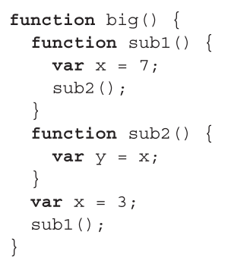
Scope
The scope of a variable is the range of statements in which the variable is visible.
A variable is local in a program unit or block if it is declared there
STATIC SCOPE (a.k.a lexical scoping)
scope of a variable can be statically determined prior to execution
two categories of static-scoped languages: nested vs. non-nested
If a suitable declaration is not found in the static parent the search continues in to static ancestors (enclosing subprogram)

Slide 7
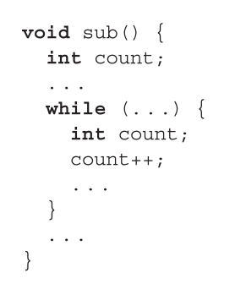
Scope
The scope of a variable is the range of statements in which the variable is visible.
Blocks (a section in the code)
storage is allocated when the section is entered and deallocated when the section is exited
compound statement - a statement sequence surrounded by matched braces

Slide 8
Scope
The scope of a variable is the range of statements in which the variable is visible.
GLOBAL SCOPE
Definitions can appear outside the functions
visible to those all functions.
extern qualifier - global variable that is defined after a function can be made visible in the function by declaring it to be external
Scope Resolution Operator (::) – Enables the access of a global variable that is hidden by a local with the same name

Slide 9
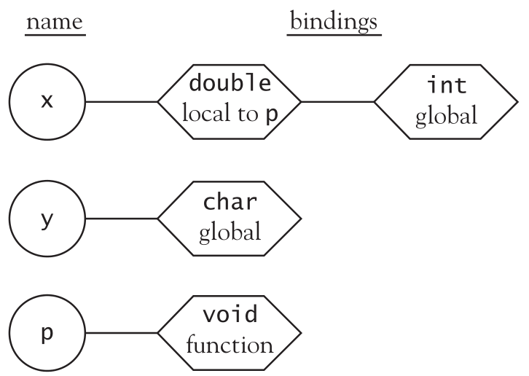
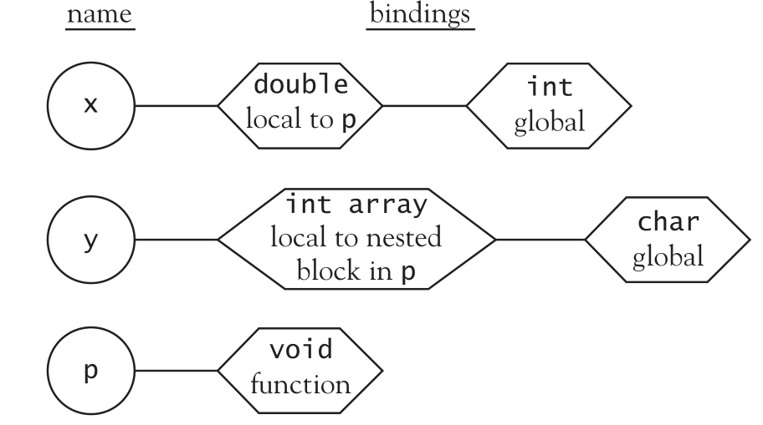
Static Scoping
(1) int x;
(2) char y;
(3) void p(){
(4) double x;
(5) ...
(6) { int y[10];
(7) ...
(8) }
(9) ...
(10) }
(11) void q(){
(12) int y;
(13) ...
(14) }
(15) main(){
(16) char x;
(17) ...
(18) }
Symbol table structure at line 5
Symbol table structure at line 7

Slide 10
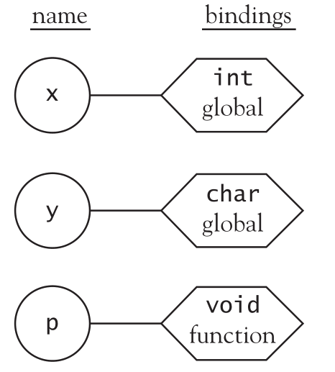
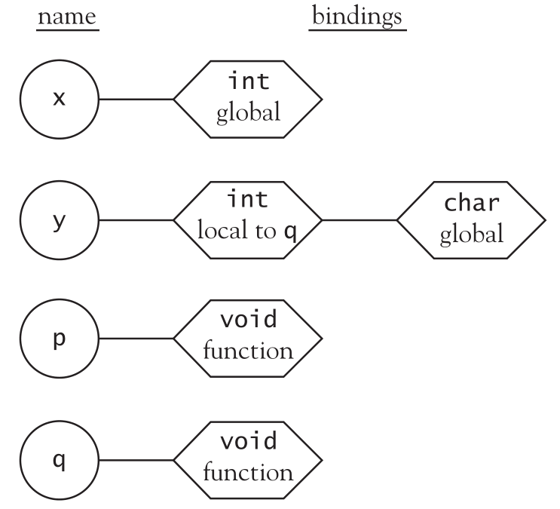
Static Scoping
(1) int x;
(2) char y;
(3) void p(){
(4) double x;
(5) ...
(6) { int y[10];
(7) ...
(8) }
(9) ...
(10) }
(11) void q(){
(12) int y;
(13) ...
(14) }
(15) main(){
(16) char x;
(17) ...
(18) }
Symbol table structure at line 10
Symbol table structure at line 13

Slide 11
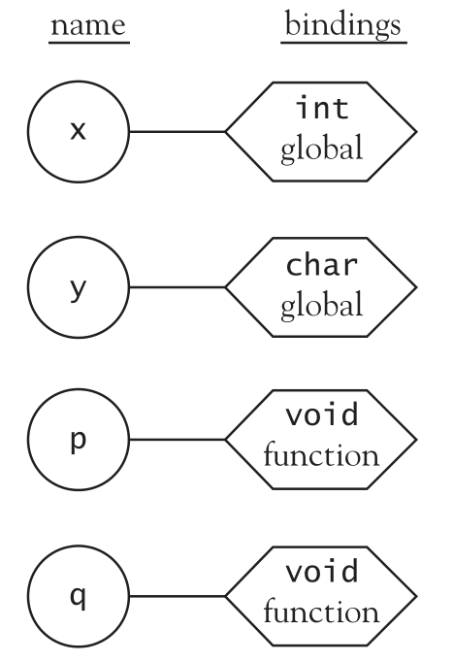
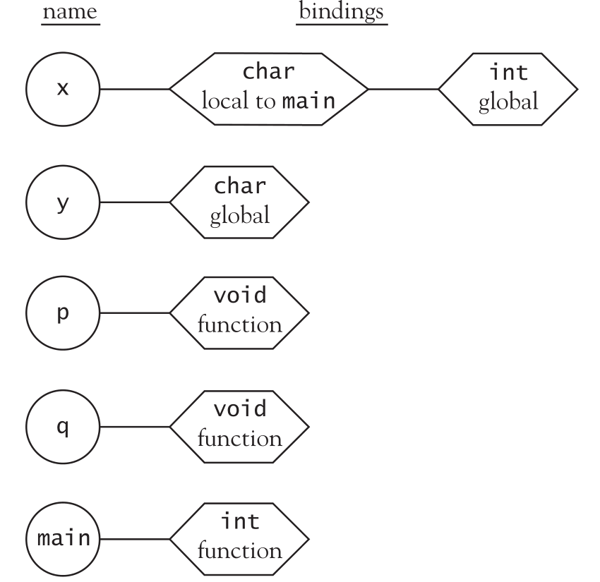
Static Scoping
(1) int x;
(2) char y;
(3) void p(){
(4) double x;
(5) ...
(6) { int y[10];
(7) ...
(8) }
(9) ...
(10) }
(11) void q(){
(12) int y;
(13) ...
(14) }
(15) main(){
(16) char x;
(17) ...
(18) }
Symbol table structure at line 14
Symbol table structure at line 17

Slide 12
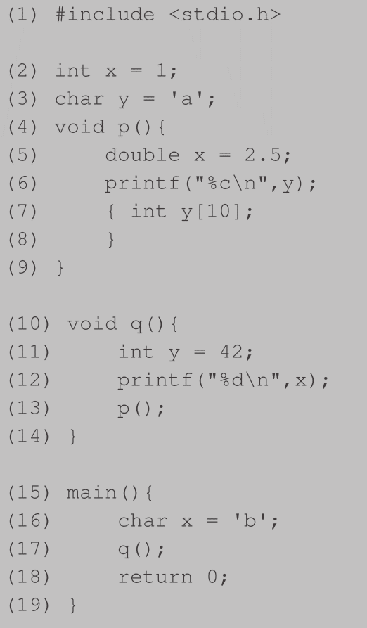
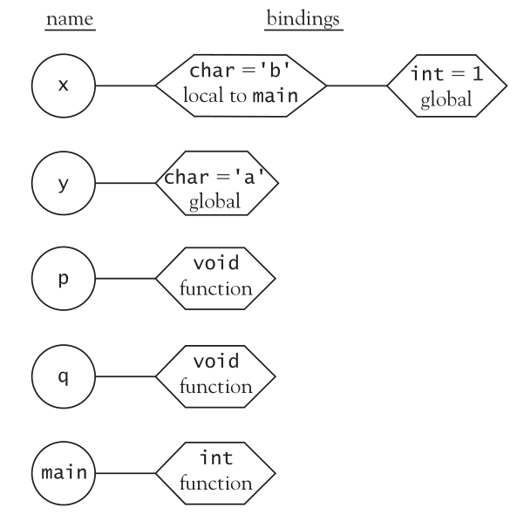
Dynamic Scoping
Symbol table structure at line 17

Slide 13
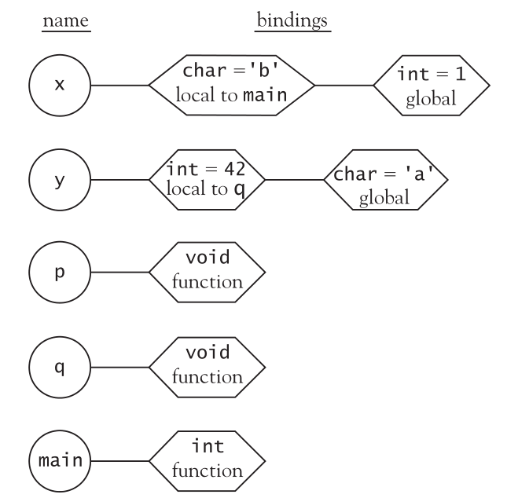
Dynamic Scoping
Symbol table structure at line 12

Slide 14
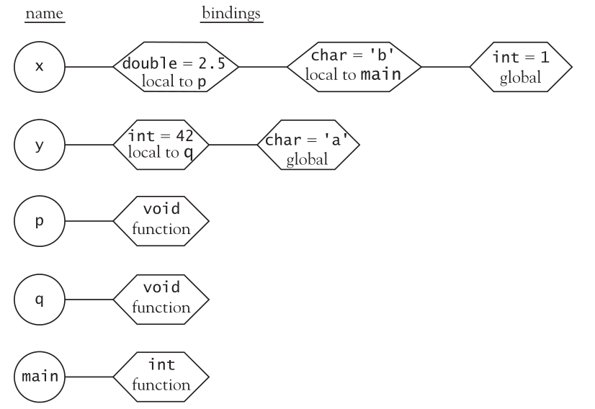
Dynamic Scoping
Symbol table structure at line 6

Slide 15
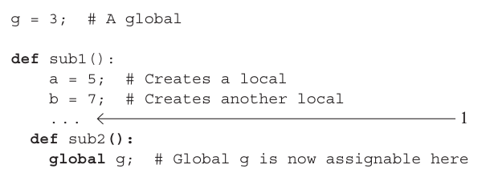
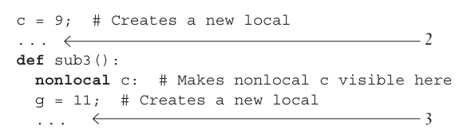
Referencing Environments
referencing environment of a statement is the collection of all variables that are visible in the statement.

Slide 16
Named Constants
A named constant is a variable that is bound to a value only once.
The binding of a variable to a value at the time it is bound to storage is called initialization
Pros:
Readability
Reliability

Slide 17
Question 1
Assume the following JavaScript program was interpreted using static-scoping rules.
What value of x is displayed in function sub1?
Under dynamic-scoping rules, what value of x is displayed in function sub1?
var x;
function sub1() {
document.write("x = " + x + "<br />");
}
function sub2() {
var x;
x = 10;
sub1();
}
x = 5;
sub2();
Static scoping: x = 5.
Dynamic scoping: x = 10

Slide 18
Question 2
Consider the following JavaScript program:
var x, y, z;
function sub1() {
var a, y, z;
function sub2() {
var a, b, z;
. . .
}
. . .
}
function sub3() {
var a, x, w;
. . .
}
List all the variables, along with the program units where they are declared, that are visible in the bodies of sub1, sub2, and sub3, assuming static scoping is used.

Slide 19
Variable Where Declared
In Sub1:
A Sub1
Y Sub1
Z Sub1
X Main
In Sub2:
A Sub2
B Sub2
Z Sub2
Y Sub1
X Main
In Sub3:
A Sub3
X Sub3
W Sub3
Y Main
Z Main

